Slide 1
Customer Support Chat Bot using llm model
01st Sep'23

Slide 2
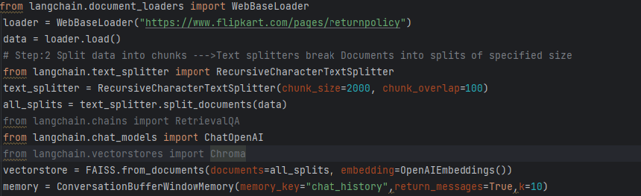
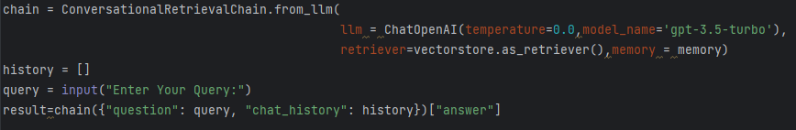
Task:- Customer Support Chatbot
Objective Customer Support Chabot Application will Retrieve information from customer Knowledge base (e.g Flipkart refund /return policy) and respond to queries in real time.
Code Overview

Slide 3
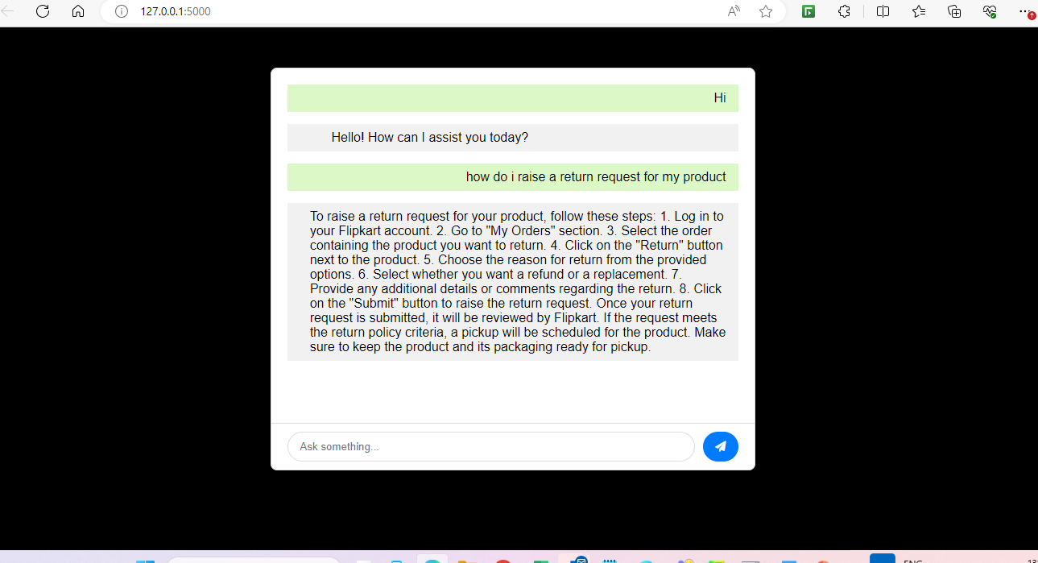
Sample Customer Support Chat Bot

Slide 4
Thanks

